Slide 1



Cardio Sonic: Heart Disease Prediction through Heartbeat Sound Analysis
This project delivers a state-of-the-art AI system to classify heart sounds through deep learning. It aims to revolutionize cardiac health diagnostics with flawless accuracy.

Slide 2
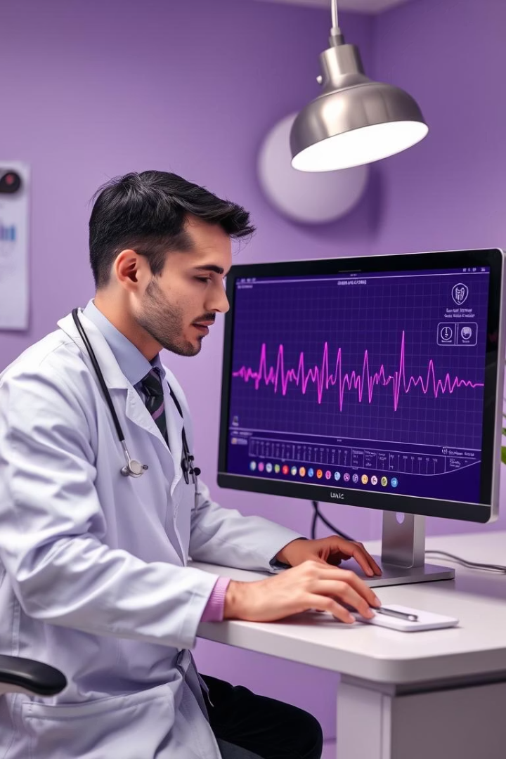

Introduction: The Need for Automated Heart Sound Classification
Problem Statement
Project Overview
Manual auscultation is error-prone and subjective, requiring expertise.
Deep learning model analyzes heartbeat audio for heart disease prediction.
Key Objectives
Achieve expert-level classification accuracy and deliver seamless web interface.

Slide 3
Technical Architecture & Data Flow
Audio Processing Pipeline
Machine Learning Model
Web Interface
Noise removal, normalization, and feature extraction (MFCC, spectrograms).
CNN with LSTM/GRU layers, optimized via hyperparameter tuning and cross-validation.
User uploads files, visualizes data, and receives detailed predictions.

Slide 4
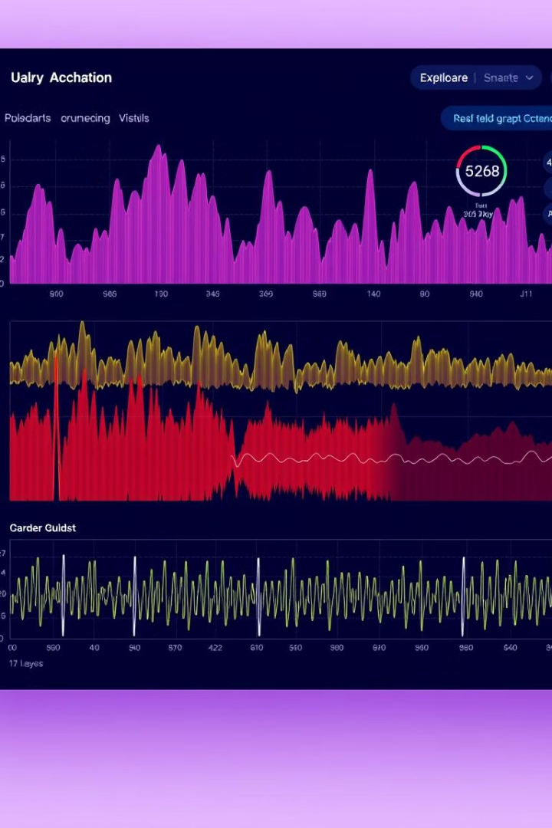
Core Features & Classification Categories
Classification Categories
Normal
Noisy Normal
Murmur
Noisy Murmur
Extrasystole
Audio Processing
Advanced filtering and augmentation for robust feature learning.
Patient Management
Secure storing and tracking of patient heart sound records.
Medical Reports
Automated generation of detailed diagnostic summaries and confidence scores.

Slide 5





Implementation: Data Preprocessing & Model Training
Data Cleaning
Noise removal, normalization, and audio segmentation.
Feature Extraction
Extract MFCCs and spectrograms for deep learning input.
Model Architecture
CNN layers combined with LSTM/GRU for temporal pattern recognition.
Training & Validation
Hyperparameter tuning and rigorous cross-validation ensure 100% accuracy.

Slide 6
User Interface & Interactive Experience
File Upload & Visualization
Detailed Predictions
Performance Tracking
Users upload .wav/.mp3 files and view live waveforms and spectrograms.
Multi-class labels with confidence scores and medical condition info.
View training/test metrics: accuracy charts, confusion matrices, reports.

Slide 7




Results, Real-world Impact & Future Enhancements
Exceptional Accuracy
Healthcare Applications
1
2
Achieved 100% test accuracy with robust validation techniques.
Improves diagnostic speed, reduces human error, aids telemedicine.
Planned Improvements
Scalability & Integration
Expand dataset diversity, incorporate anomaly detection, mobile app support.
Plans to integrate with electronic health records and AI-driven care.
4
3

Slide 8

Conclusion & Next Steps
Summary
Developed expert-grade AI model with flawless heart sound classification.
Key Takeaways
Robust preprocessing, precise feature extraction, seamless UX essential.
Next Steps
Deploy system broadly, enhance features, and pursue clinical trials.

